Slide 1
Data Preprocessing
Jason Phillips
Mohammad Ameri
Ryon Faroughi
Youser Alalusi
Yusran Sadman

Slide 2
Overview
Introduction to the data
Issues with the data
Cleaning the Data
Analysis
Conclusion

Slide 3
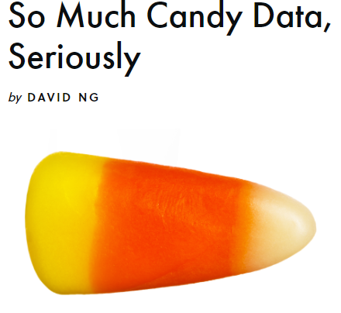
Introduction
To the
Dataset
The data we chose-
A candy hierarchy dataset for 2017
The survey gathered data on different types of candies and how they made the participants feel.
The choices ranged from “DESPAIR”, “MEH”, and “JOY”
Other question asked were the participants age, their country of location, their gender, and whether they are going out or staying in for halloween.
Information we can gather from the data-
What candy seems to be thought of the highest?
Does a certain gender feel a certain way about certain candies or chocolate?
Does a country enjoy a specific candy more than other countries?

Slide 4
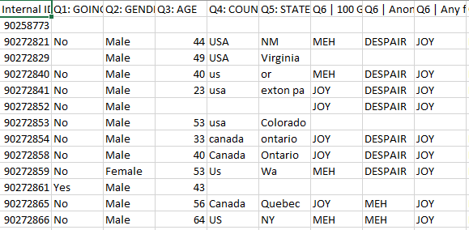
Issues with the data
Immediate issues with the data-
Missing Values
Unnecessary Columns
Off topic data
Non-serious answers
Outliers
Solutions to these issues (Overview)
Drop columns with over 50% missing values.
Replace remaining missing values with useful alternatives
Drop any column that serves no meaningful purpose to our dataset.
Drop rows with non serious responses.
Drop the outliers.
Manipulate the data to the point where it can be analyzed.

Slide 5
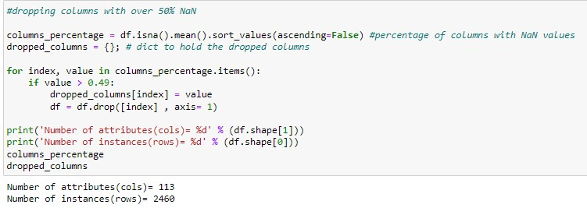
By using this technique we were able to reduce the fields to 113 from 120., which is very critical to purify our data.
The Industry standard percentage for dropping columns plagued with missing values is 25%-30% and can go up to ~50%.
To begin my process of tidying up this sloppy candy data we first looked into removing the bad data. First we decide to drop any fields that has more than 50% of missing or NaN values, to achieve that we used mean() on the fields and any fields over 49% of empty value dropped from our dataFrame.

Slide 6
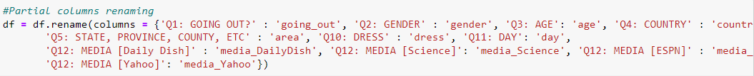
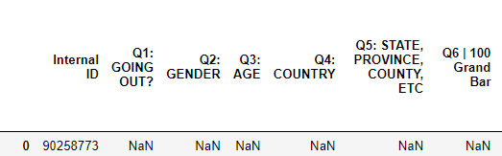
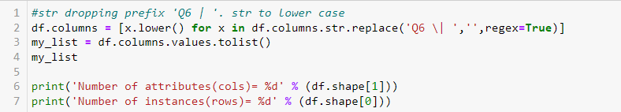
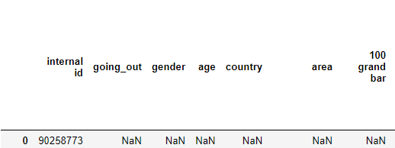
Renaming Some Columns
Renaming a few columns to make the data easier to work with.
Dropping the “Q” prefixes from each column to make manipulating the data easier later on.

Slide 7
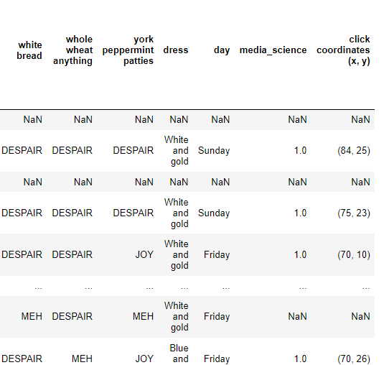
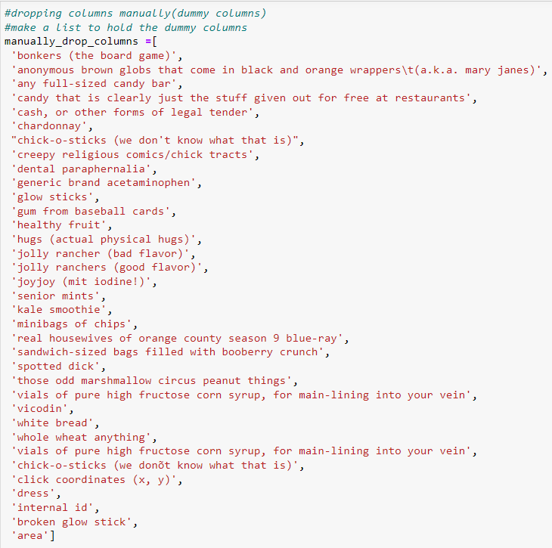
Drop the Dummy Columns
There were a few columns that were not related to the data.
Some were random objects or question about topics completely unrelated to candy.
Manually drop all columns that were irrelevant to our study.

Slide 8
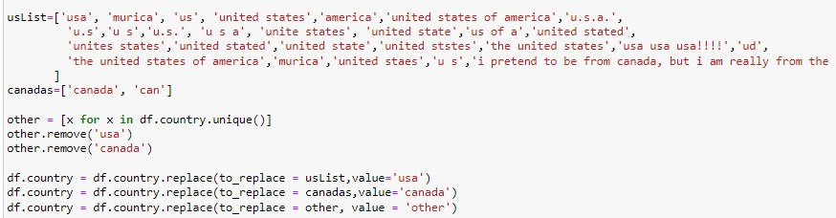
Since the majority of the participants (about 95%) were from the U.S and Canada we decided to list them only and remove the other 49+ from our data and categorize them as others.
The other main issue we faced was in the country field where the participants had the freedom of inputting any string in the field which resulted in many different names for the same country as an example:
('usa', 1117),('united states', 585),('us', 180), ('united states of america', 72),('u.s.', 12)
And many others, so we decided to clean up that field and all the records within.

Slide 9
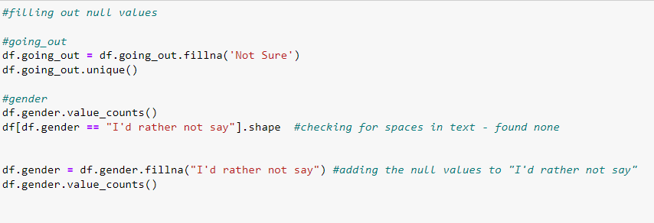
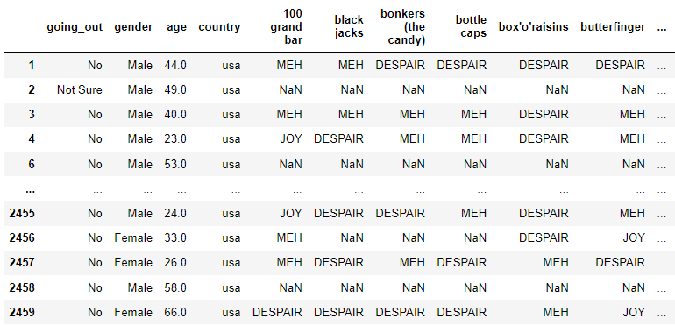
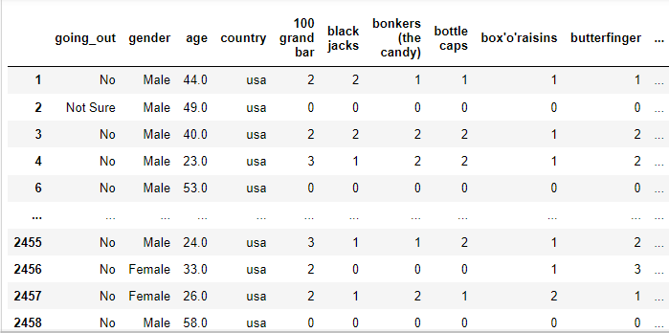
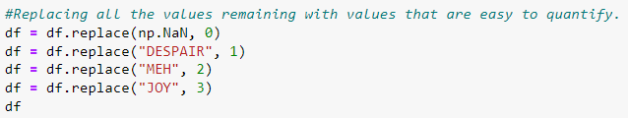
Replacing and Removing Data
Replace Empty values with data that can still be measured (ex. Instead of empty, perhaps they didn’t want to answer).
Replace the values of JOY, MEH, and DESPAIR with numbers to make it easier to quantify.
Replace any remaining NaN values with 0.

Slide 10
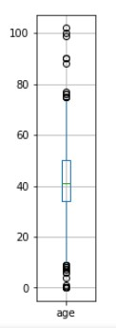
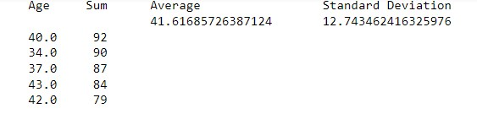
Z- score and outliers
Calculate the Z-Score
In this procedure we calculate the z-score for each value in the age field. Any z-score greater than 3 or less than -3 is considered to be an outlier. This rule of thumb is based on the empirical rule. From this rule we see that almost all of the data (99.7%) should be within three standard deviations from the mean. By calculating the z-score we are standardizing the survey, meaning the standard deviation is now 1. Thus from the empirical rule we expect 99.7% of the z-scores to be within -3 and 3.

Slide 11
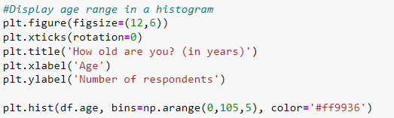
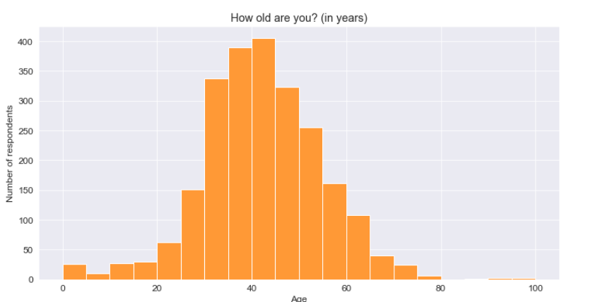
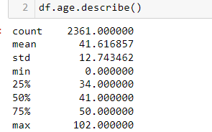
Analyzing the Data
(Age)
Display the clean information in a format that makes it easy to analyze and interpret.
More ways to visualize the data

Slide 12
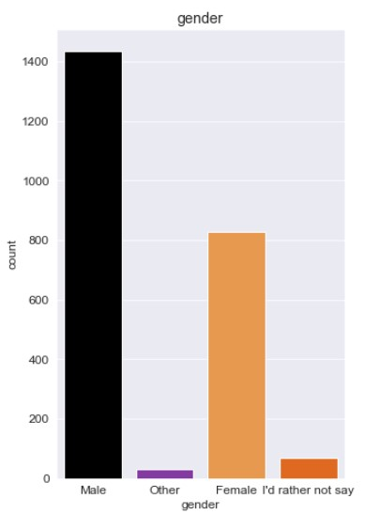
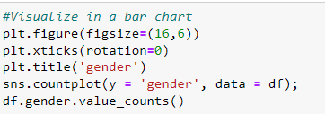
Analyzing the Data(Gender)
Analyzing the Data(Gender)
Display the info for better analysis
More males took the survey than any other gender.

Slide 13
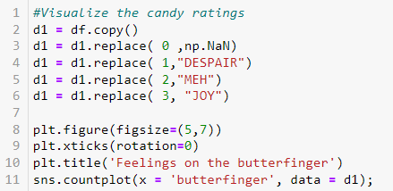
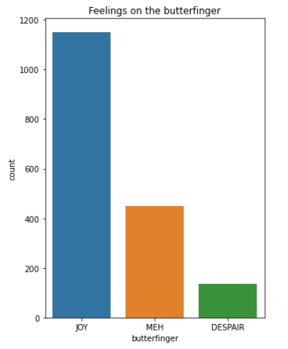
Analyzing the Data (The Candy)
Apply the previous techniques to analyze any candy that we want.
Using this, we can see that more people feel highly of Butter Fingers rather than low.

Slide 14
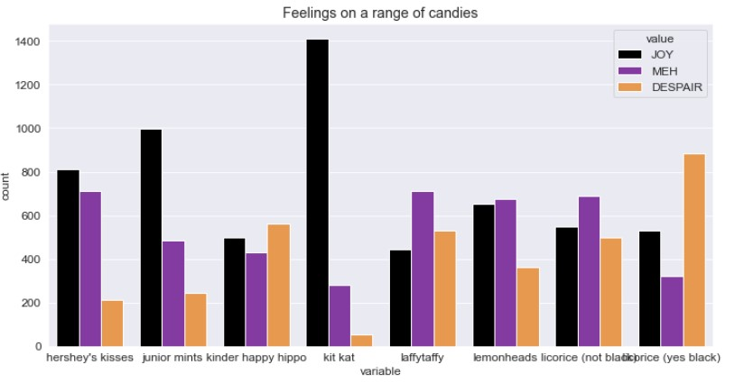
Analyzing feelings towards selection of candies. For this we used melt function.
.melt() function rotates data like a pivot table
KitKat was the most joyed candy.

Slide 15
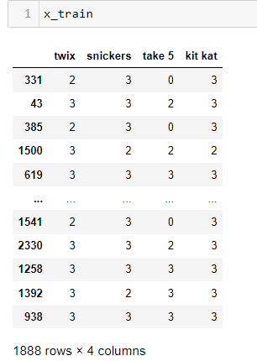
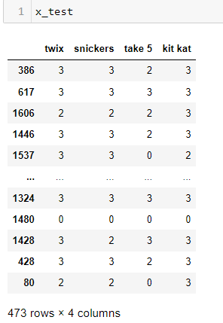

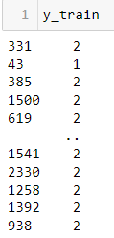
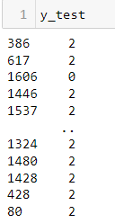
Splitting the Data
Create a new column and have another column be encoded to fit that new column.
Split the data. 80% is the training set, 20% is the test set.
#Splitting the data into test and training sets. Ratio is 75 to 25
x_train, x_test, y_train, y_test = train_test_split(df[['twix','snickers','take 5','kit kat']],df['Country Joy'],test_size = .20, random_state=42)

Slide 16
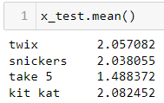
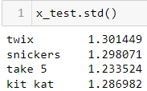
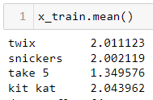
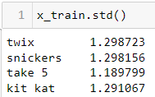




Splitting the Data(contd.)
X_test:
X_train:
Y_test:
Y_train:

Slide 17
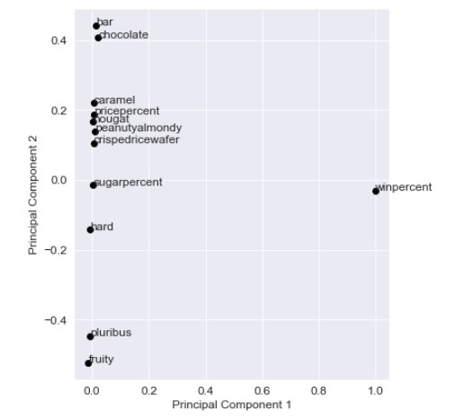
Principal Component Analysis
Except sugarbyprice and winbyprice, all the other features seem to be clustered.

Slide 18
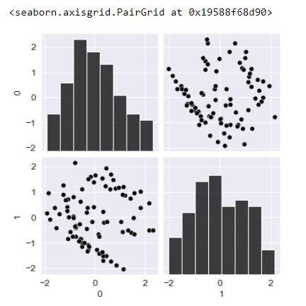
Transform Data. Scale Data.
df_pca = pca.transform(data1.drop('competitorname', axis=1)) # our data transformed with new features as principal components.
df_pca = df_pca[:, 0:2] # Since we require first two principal components only.
standard_scaler = StandardScaler()df_s = standard_scaler.fit_transform(df_pca) # s in df_s stands for scaled.
sns.pairplot(pd.DataFrame(df_s)) # Try to get some intuition of data

Slide 19
Conclusion
Pre-Processing is a vital step in Data Mining and must be done in a specific way
Resulted in a clean data set that we will be able to use in future projects and help us proceed in the process of Data Mining.

